Slide 1

ADVANCED NEURAL NETWORK
DATA HANDLING
Building High-Performance Models Through Better Data Strategy
Group 1: Richard, Yoana, Kaden, Juphens
1 / 12

Slide 2
WHAT THIS SESSION COVERS
01
▸ Compare data‑centric improvement with model & hyperparameter tuning
▸ Review advanced augmentation techniques (AutoAugment, Mixup, CutMix)
▸ Address data handling across CNN, RNN, and Transformer architectures
▸ Evaluate annotation quality using inter‑annotator agreement metrics
▸ Use active learning to reduce labeling cost
▸ Design production‑ready data pipelines
▸ Identify and mitigate common data challenges
02
03
04
05
06
07
2 / 12

Slide 3
WHY DATA QUALITY MATTERS MORE THAN MODEL TUNING
Data-centric improvements consistently deliver greater gains than incremental changes to model architecture or hyperparameters. Stronger outcomes come from higher dataset quality, broader coverage, and smarter augmentation strategies.
KEY INSIGHT
"Improving data is often the highest-leverage activity for improving model performance."
QUALITY
DIVERSITY
LABELING
Better data often outperforms more complex models
Coverage and variety improve model generalization
High-quality labels reduce avoidable model errors
3 / 12

Slide 4
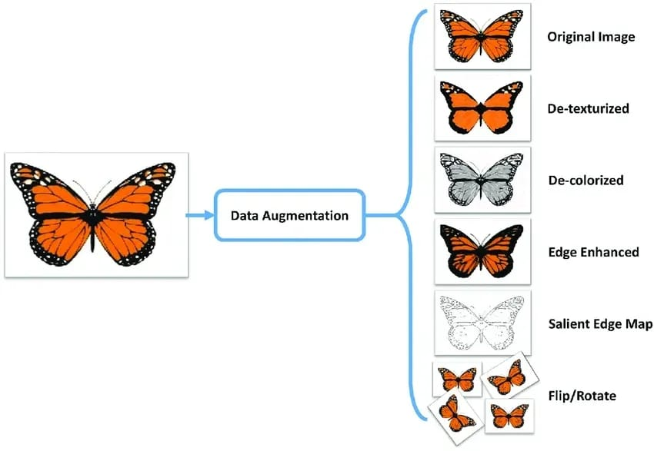
AUGMENTATION STRATEGIES THAT SCALE PERFORMANCE
IMAGE DATA
SEQUENCE & OTHER MODALITIES
▸ AutoAugment — search for optimal augmentation policies
▸ Mixup — linear interpolation between training examples
▸ CutMix — patch-level mixing across images
▸ Adversarial Training — robustness to perturbations
▸ Noise injection & time warping
▸ Random cropping & masking
▸ Token substitution for NLP tasks
▸ MixSeq — combine segments across sequences
4 / 12

Slide 5
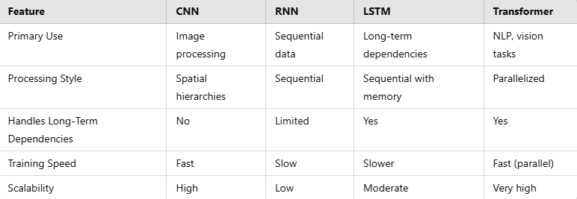
TAILORING DATA STRATEGY TO MODEL ARCHITECTURE
CNNs
RNNs
TRANSFORMERS
Augmentation for invariance
Variable-length sequences with padding & masking
Context windows & efficient attention
Local + global context via receptive fields
Teacher forcing & scheduled sampling
Masking aligned with prediction objectives
Batch normalization & residual connections
Bidirectional & gated recurrent variants
Embeddings & prompt structure optimization
5 / 12

Slide 6
RELIABLE LABELS DRIVE RELIABLE MODELS
Annotation quality should be measured, reviewed, and improved systematically — not assumed. Treat labeling quality as a core part of model quality assurance.
Cohen's κ
Fleiss' κ
Krippendorff's α
F1 Score
Pairwise agreement between two annotators
Agreement across multiple annotators
Handles missing data & multiple coders
Precision-recall balance for label quality
BEST PRACTICES
▸ Conduct regular review cycles and adjudication processes
▸ Track inter-annotator agreement continuously
▸ Integrate labeling QA into the model training workflow
6 / 12

Slide 7
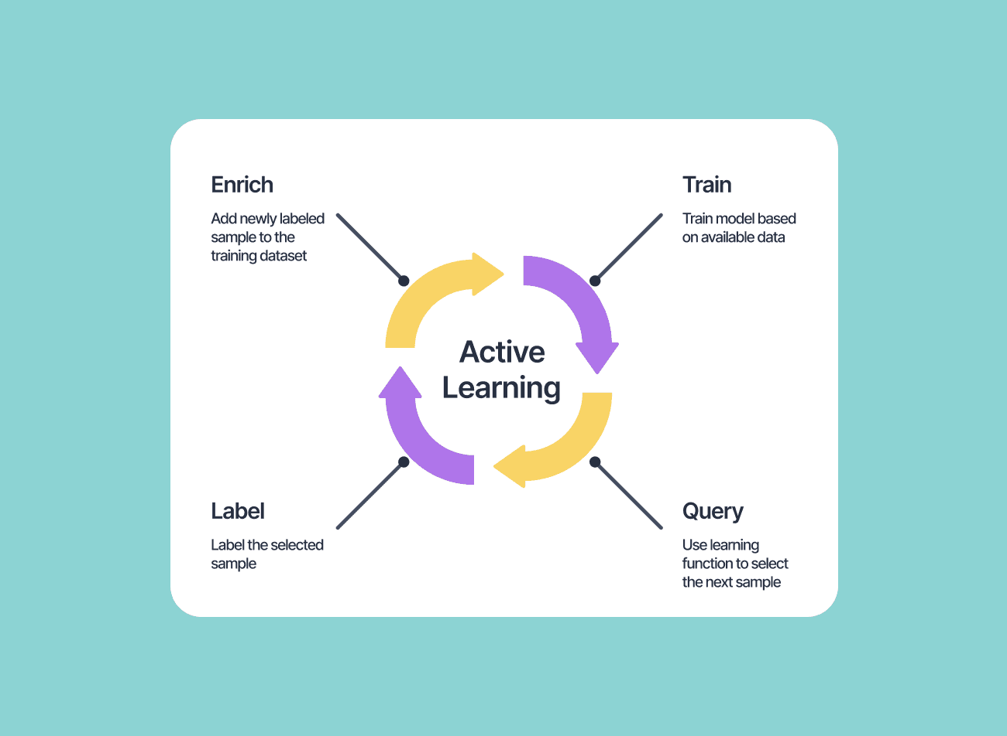
LABEL LESS, LEARN MORE
Active learning prioritizes the most informative samples, reducing labeling effort while preserving performance.
1
2
3
4
5
Start with labeled subset
Train initial model
Query via uncertainty / diversity
Label selected samples
Retrain & repeat
IMPACT
Comparable model performance can be achieved using only 30–50% of the full labeled dataset, dramatically reducing annotation cost and time.
7 / 12

Slide 8
OPERATIONALIZING THE DATA PIPELINE
INGESTION
PRE-PROCESSING
ANNOTATION
MODEL TRAINING
MONITORING
PIPELINE BEST PRACTICES
COMMON CHALLENGES
▸ Build traceability across each pipeline stage
▸ Standardize preprocessing and validation steps
▸ Monitor post-deployment behavior continuously
▸ Treat pipeline health as part of model performance
▸ Class imbalance & rare events
▸ Noisy labels & annotation errors
▸ Data drift & distribution shift
▸ Concept shift over time
MITIGATION
▸ Structured error analysis
▸ Feature importance & attribution tools
▸ Resampling & rebalancing strategies
8 / 12

Slide 9
DATA-DRIVEN PERFORMANCE GAINS
CASE STUDY 1: CLASSIFICATION BOOST
CASE STUDY 2: OBJECT DETECTION
+35%
−40%
ACCURACY INCREASE
FALSE POSITIVES REDUCED
Mixup + AutoAugment applied to image classification task vs. baseline training.
Curated dataset + CutMix improved object detection performance.
9 / 12

Slide 10
WHAT MATTERS MOST
01
Prioritize data quality, diversity, and augmentation over architecture complexity
02
Adapt data handling strategies to the specific model architecture (CNN, RNN, Transformer)
03
Measure annotation quality explicitly using validated inter-annotator agreement metrics
04
Use active learning to improve labeling efficiency and reduce annotation cost
05
Build robust pipelines that detect and respond to data drift, noise, and distribution shift
10 / 12

Slide 11
RECOMMENDED NEXT STEPS
🔍
⚡
✅
🔄
📊
AUDIT
AUGMENT
ANNOTATE
ACTIVATE
MONITOR
Review your current data pipeline for quality gaps and bottlenecks
Introduce advanced augmentation techniques selectively
Review annotation quality metrics and establish regular QA cycles
Pilot an active learning loop to optimize labeling efficiency
Strengthen monitoring for drift, noise, and labeling issues
11 / 12

Slide 12
THANK YOU
Advanced Neural Network Data Handling
Building High-Performance Models Through Better Data Strategy
12 / 12

Slide 13
References
[1] Brownlee, J. (2019). Machine Learning Performance Improvement Cheat Sheet. Machine Learning Mastery. Data-centric changes like adding more or better data often yield greater gains than algorithm tuning(machinelearningmastery.com).
[2] Byrd, J. (2024). The Full Guide to Data Augmentation in Computer Vision. Encord Blog. Explains how data augmentation increases dataset size and acts as a regularization technique(encord.com).
[3] GeeksforGeeks. (2025). Active Learning for Reducing Labeling Costs. Active learning can achieve comparable or superior performance while labeling only 30–50% of the data(www.geeksforgeeks.org).
[4] TELUS Digital. (2023). Four key metrics for ensuring data annotation accuracy. Introduces metrics such as Cohen’s kappa, Fleiss’ kappa, Krippendorff’s alpha, and F1 score for evaluating annotation quality(www.telusdigital.com).

